Slide 1
Zuul API Gateway - A Quick Start
Zuul API gateway will be a single entry point to our multiple instances of running micro services.

Slide 2
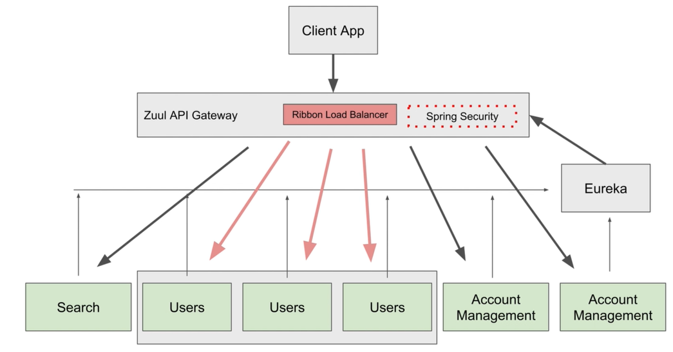

Slide 3
Create a ZUUL API Gateway Project

Slide 4
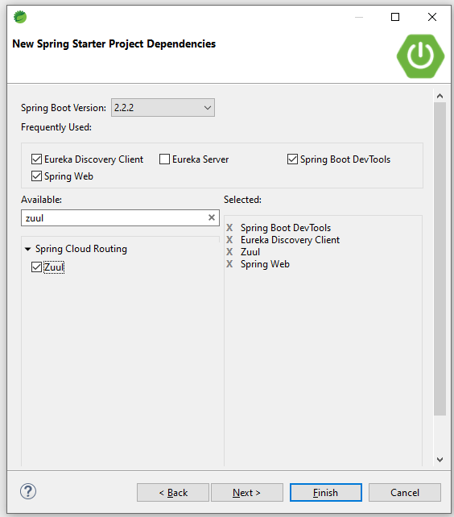

Slide 5
Access Microservices via API Gateway //example: http://localhost:8011/users-ws/users/status/check

